Slide 1
Delta x Sapphire conduent quick move
Vignesh m

Slide 2
Two cars starts at the same time from A and B which is 120 km apart. If the two cars travel in opposite direction they meet after one hour and if they travel in same direction (from A towards B) then A meet B after 6 hours. What is the speed of car starting from A?
a)70 kmph
b)60 kmph
c)50 kmph
d)120 kmph

Slide 3
A super fast express overtakes a passenger train in 20 seconds. The speed of the faster train is 72 km/h and speed of the slower train is 27 km/h. If the length of the faster train is 100 m. Find the length of the slower train ?
a) 125 m
b) 150 m
c) 175 m
d) 200 m

Slide 4
A train sets off at 2 p.m. at the speed of 70 kmph. Another train starts at 3:30 p.m. in the same direction at the rate of 85 kmph. At what time the trains will meet?

Slide 5
Twenty women can do a work in sixteen days. Sixteen men can completed the same work in fifteen days. What is the ratio between the capacity of a man and women?
a) 3:4 b) 4:3 c) 5:3
5 mat-weavers can weave 5 mats in 5 days. At the same time, how many mats would be woven by 10 mat- weavers in 10 days?
a. 10 mats b. 15 mats c. 20 mats d. 30 mats

Slide 6
A can finish a work in 18 days and B can do the same work in 15 days. B worked for 10 days and left the job. In how many days, A alone can finish the remaining work?
a) 5 b) 7 c ) 6 d) 8
X and Y can do a piece of work in 20 days and 12 days respectively. X started the work alone and then after 4 days .Y joined him till the completion of the work. How long did the work last?
a) 6 days b) 10 days c) 15 days d) 20 days

Slide 7
A fruit seller had some apples. He sells 35% apples and still has 390 apples. Originally he had
(A) 600 (B) 540 . (C) 650 (D) 580
At an election there were two candidates. A candidates got 38% vote and lost by 7200 number of votes. The total number of valid votes were:
(a) 13000 (b) 13800 (c) 16200 (d) 30000
Of the 1000 people of a town 60% are males of whom 20% are literate. If all the peoples 25% are literate then what percent of the females of the town are literate?
(a) 22.5% (b) 27.5 % (c) 32.5 % (d) 37.5 %

Slide 8
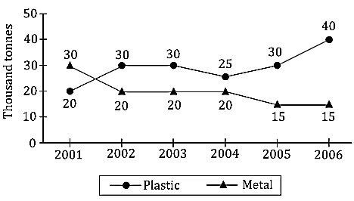
Answer the questions given as per details given in the graph, which provides the consumption of metal and plastic across 6 years.
What is the ratio of the total consumption of metal to that of plastic in the given period?
(a) 4:5 (b) 18:23 (c) 19:23 (d) 24:35

Slide 9
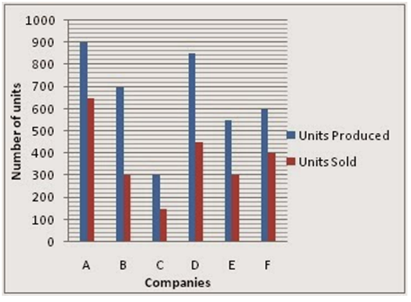
Study the following graph carefully and answer the questions given below it.
Production and sale of printers of various companies in a month.
What is the average number of units sold by all the companies together?
(a) 360 (b) 390 (c) 375 (d) 410

Slide 10
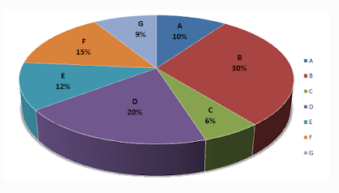
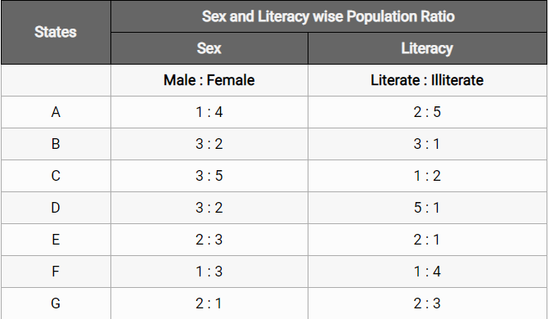
Study the following graph and the table and answer the questions given below.
Data of different states regarding population of states in the year 2012
Total population of the given states = 2000000.

Slide 11
What was the number of males in D state in the year 2012?
(a) 220000 (b) 120000 (c) 260000 (d) 240000

Slide 12
Hari sold his horse for Rs. 3270 and gain 9%. Then Hari bought the horse for
(a) 3020 (b) 3150 (c) 3000 (d) 3250
On selling an article for Rs. 400, a man loses 20%. What will be the selling price, if desired profit is 10%?
(a) Rs. 500 (b) Rs. 550 (c) Rs. 400 (d) None of these

Slide 13
1.In a certain code BREAK is written as ASDBJ.How is SOLAR written in that code?
a) RPKBS b) TPMBS c) RPKBQ d) TPKBQ e) None of these
2.If KGLFT is written as PTOUG, the MERSA is written as ?
A) NVIHZ B) VIHNZ C) NVLHZ D) NVIHA
3.If EDUCATION is written as 5421312091514 then how is CAT written?
A) 13120 B) 312 C) 3120 D) 31209
4If DOOR = 25, LOWER=37, TOWER=18, then OVER = ?
A) 81 B) 45 C) 60 D) 06

Slide 14
In a certain code “new banking systems” is coded as “ss tp na", “officer in uniform” is coded as “or mu at”, . “new bank officer” is coded as ”or bk na” and “systems in bank” is coded as “bk at ss”.
What is the code for “in” ?
(1) as (2) or (3) at (4) mu (5) None of these

Slide 15
B is the brother of A, S is the sister of B, E is the brother of D, D is the daughter of A, F is the father of S. Then, the uncle of E is
(a) A (b) B (c) F (d) D
Pointing to a girl, Mihir said “She is the only daughter of my grandfather’s only child”. How is the girl related to Mihir ?
(1) Daughter (2) Niece (3) Sister (4) None of these
Anil, introducing a girl in a party. said, ‘She is the wife of the grandson of my mother’. How is Anil related to the girl?
(1) Father (2) Grandfather (3) Husband (4) Father-in-law (5) None of these

Slide 16
bag contains 3 blue, 2 green and 5 red balls. If four balls are picked at random, what is the probability that two are green and two are blue?
1/18
(b) 1/70
(c) 3/5
(d) 1/2

Slide 17
A box contains 3 red and 4 green marbles. If three marbles are picked at random. What is the probability that two are green and one is red ?
(a) 18/35
(b) 4/21
(c) 3/7
(d)5/14

Slide 18
A bag contains 5 red balls, 6 yellow balls and 3 green ball .If two balls are picked at random what is the probability that either both are red on both are green in colour?
(a) 3/7
(b) 5/14
(c) 1/7
(d) 2/7

Slide 19
THANK YOU

